Slide 1
Lesson objective
Title: Fractions
Aim – be able to:
Create equivalent fractions to use when adding or subtracting
convert proper and improper fractions
Plan:
Equivalent fractions
Addition and subtraction
Need whiteboards.

Slide 2
Creating equivalent fractions
I do
We do
$$\frac{3}{4}=$$
$$\frac{5}{7}=$$
$$\frac{4}{6}= \frac{}{18}$$
$$\frac{4}{9}=$$
$$\frac{2}{5}=$$
$$\frac{3}{5}=\frac{12}{}$$
Factor of 2
Factor of 2
Factor of 5
Factor of 5
Factor of ?
Factor of ?

Slide 3
Remember:
We can use ANY factor when creating an equivalent fraction, as long as we multiply BOTH top AND bottom number by the SAME factor.

Slide 4
Whiteboards
Create an equivalent fraction using a factor of 2 (times by 2)
$\frac{4}{5}$
$\frac{2}{10}$
$\frac{3}{7}$

Slide 5
Whiteboards
Create an equivalent fraction using a factor of 3 (times by 3)
$\frac{4}{5}$
$\frac{2}{10}$
$\frac{3}{7}$

Slide 6
Whiteboards
Create an equivalent fraction using a factor of 5
$\frac{4}{5}$
$\frac{2}{10}$
$\frac{3}{7}$

Slide 7
Find the equivalent fraction
Which fraction is equivalent to $\frac{2}{4}$
$\frac{2}{8}$
$\frac{5}{10}$
$\frac{4}{8}$
What are some ways we can check?

Slide 8
Why equivalent fractions?
Addition and subtraction of fractions require a common denominator.
Addition and subtraction of fractions _____ a common denominator.
Addition and subtraction of fractions _____ a common ___________
What do we need to add and subtract fraction?

Slide 9
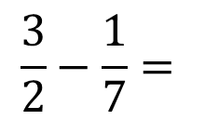
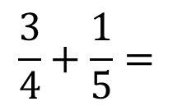
Lowest common denominator, shared factors
List the multiples of each denominator.
Circle the smallest multiple of BOTH numbers (matching multiples).
The LCM is the new denominator for both fractions.
Multiply the numerator by the same number as the original denominator.
4 and 5
2 and 7
$$\frac{3}{4}+\frac{1}{5}=$$
$$\frac{3}{2}−\frac{1}{7}=$$
 | 2 | 7
Multiples | 4 | 7
 | 6 | 14
 | 8 | 21
 | 10 | 28
 | 12
 | 14
 | 4 | 5
Multiples | 4 | 5
 | 8 | 10
 | 12 | 15
 | 16 | 20
 | 20

Slide 10

What about…
List and circle the LCM of:
3 and 6
 | 3 | 6
Multiples | 6 | 12
 | 9 | 18
 | 12 | 24
 | 15 | 30
 | 18 | 36
$$\frac{1}{3}+\frac{5}{6}=$$

Slide 11
White boards
List and circle the LCM of:
3 and 5
2 and 9
5 and 10
Multiples

Slide 12

Steps
Check denominators (change to LCM if needed)
Add or take top numbers, denominators stay the same
Simplify if possible
$$\frac{3}{9}+\frac{1}{3}=$$
$$\frac{4}{5}−\frac{1}{3}=$$

Slide 13

Adding fractions with LCM
Example (I do)
$$\frac{4}{7 }+ \frac{1}{3}=$$
$$\frac{4}{5}+ \frac{2}{6}=$$
$$\frac{4}{12}+ \frac{10}{24}=$$
List the multiples of each denominator.
Circle the smallest multiple of BOTH numbers (matching multiples).
The LCM is the new denominator for both fractions.
Multiply the numerator by the same number as the original denominator.

Slide 14

Adding fractions (we try )
List the multiples of each denominator.
Circle the smallest multiple of BOTH numbers (matching multiples).
The LCM is the new denominator for both fractions.
Multiply the numerator by the same number as the original denominator.
$$\frac{3}{4}+ \frac{2}{5}=$$
$$\frac{9}{12}+ \frac{1}{3}=$$

Slide 15
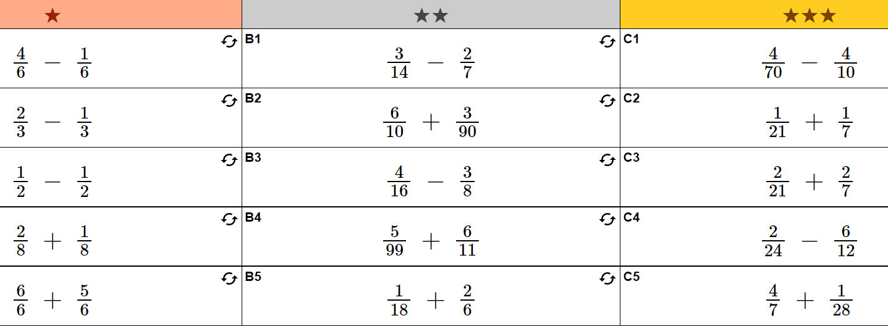

Slide 16
